Slide 1
Senior – Junior Parent Night Preparing for Graduation and Beyond
Presented by:
VMHS Counseling Department
September 26, 2022
Notes:
Welcome to our annual parent night!

Slide 2
Welcome
VMHS Principal, Celeste Scallion

Slide 3
Counseling and Senior Administrator: Heather Just
Intervention and Junior Administrator: Brianna Burow
Counseling Secretaries:
East Hall: Rachel Lazo & Courtney Hansen ext 6676
(Kimble, Osorio, Padilla and Valenzuela)
West Hall: Kristin Fuller & Jackie Moran ext 6690
(Candaele, Hill, Peterson, Tyler)
Registrars:
Michelle Morris, A-K ext 6684
Debbie Rausa, L-Z ext 6774
Career Center:
Cara Finch ext 6589
Notes:
Introduce Counseling support team

Slide 4
Meet the Counselors
Notes:
Introduce Counselors- Celeste Scallion?

Slide 5
12th grade Focus
Meet graduation requirements
Complete all final “A-G” course requirements, including college prep English and Math are recommended
Students that complete “A-G” requirements will earn an ”A-G” medal for graduation!
Aug 1st – Nov 30th, UC application window
Oct 1st – Nov 30th CSU application window
California Community College (MSJC)
Military bound, take ASVAB and contact your recruiter
Oct 1st – March 2nd Apply for Financial Aid (FAFSA)
File the FAFSA and get an extra graduation ticket
Notes:
Heather Just-Senior Administrator

Slide 6
Graduation Requirements
CLASS OF 2023!
230 Total Number of Credits
Junior Reflective Essay - Waived
Senior Culminating Project - Waived
Community Service Hours
Class of 2023– 10 hours
Class of 2024 – 20 hours
Notes:
Heather Just- Senior Admin

Slide 7
California Colleges
Apply to UC, CSU, CCC, Common Application, Common Black Application and FAFSA:
www.californiacolleges.edu
CSU Apply available Oct 1st – Nov 30th
UC Application available Oct 1st – Nov 30th
Various deadlines for other college/universities
FAFSA launch
Notes:
We need to stress that students need to apply to CSU apply through their California Colleges account. All seniors have been logged on. California Colleges is also a resource for Senior Culminating project. Research colleges, careers, scholarships, apply to college

Slide 8
CSU San Marcos Murrieta Admissions Promise & agreement
Notes:
Alliance

Slide 9
Senior Activities
Homecoming Football Game: Friday, October 7at 7PM
Homecoming Dance: Saturday, October 8, 7-11PM
Have guest passes approved by Mr. Duran in Student Support
All attendees must complete a waiver
No Go list for attendance/behavior concerns
Winter Event: February 3rd or 4th More details to come.
Mr. Bronco: Friday, March 31, 5:30PM
Prom: Saturday, May 6, Irvine, 7-11PM
Grad Nite: May 20 *Tentative*
CLASS Awards: May 22
Senior Yearbook Signing Party: May 25, 4-6PM
Senior Checkout: Friday May 26
Senior Sunset/Farewell Rally: May 30
Graduation Practices: Morning of May 30 & 31
Graduation: Thursday, June 1

Slide 10
Yearbook Info
Currently for sale online & at the bookkeepers' windows until we sell out (usually in April). Prices go up to $91 in January and $100 in February.
Senior yearbook ads for class of 2023 grads are now available on the Jostens yearbook website: https://www.jostens.com/apps/store/ybAdDesigner/1383742/-/2021081613350315782/CATALOG_SHOP/
Ads are available in Full page, 1/2 page, 1/4 page and 1/8 page sizes.
Prices vary depending on size. Earlybird prices are available through December.
Ad sales end in February and are limited to space available.
Don't wait! Reserve your ad today and save $$!
All senior yearbook portraits are done ONLY through Studio 94 & must be taken by the end of winter break to be included in the yearbook. (951) 696-2002
This Photo by Unknown author is licensed under CC BY-NC-ND.

Slide 11
Graduation: Thursday, June 1, 2023, 6PM at the Bronco Stadium
The Vista Murrieta High School graduation regalia includes four pieces: a cap, gown, tassel, and a stole.
May choose color based on preference
Added regalia
Herff Jones serves as our partner in providing the graduation regalia to all VMHS seniors.

Slide 12
Senior Purchases – Herff Jones
Required to participate in graduation ceremony. Cap, Gown (Navy or White), Memory Tassel and VMHS stole
Cost $65 plus tax
Deadline to order – February 1st, 2023
Your senior can choose to borrow the complete unit and/or purchase individual items.
Including class rings, yearbook, announcements, etc.
How to order: Online at moongradservices.com now through _February 1st 2023
On-campus order dates:
October 12th @ both lunches
November 10th @ both Lunches
December 7th @ both Lunches
January 18th @ both lunches
February 1st @ both lunches & Open House
Contact Dallas Moon
805.716.0278 moongradservices@gmail.com
Notes:
Dallas Moon from Herff Jones

Slide 13
11th grade Focus
Grades and Test Scores are important!
Review your student's transcript, generally your student should have a total of 140 credits if they are in good standing for graduation. If less than that, plan on Summer School enrollment for credit recovery.
Register for the PSAT exam scheduled Oct. 15th – if you didn’t take it in 10th grade
Take the SAT or ACT in the spring as an additional way to determine if you are ready for college – level courses (Many CSU campuses require you to take the SAT/ACT by Dec of your senior year.
Do your best on the Smarter Balanced Summative Assessment – Your CAASPP EAP results will help determine if you are ready for college level courses before attending college. In addition to, student will be tested on Science as well. Results will be posted on student's transcript.
Community Service Hours – 20 hours
Notes:
Brianna Burow- Main points for juniors
The importance of the CAASP, Remind parents that we just met with most of all of their juniors and have reviewed graduation status and grades with students. Also reviewed the timelines with them as well
Interject about Free/reduced lunch qualified students can get fee waivers for taking the SAT/ACT/AP exams.

Slide 14
SAT/ACT updates for FALL 2022 applicants
TEST-free
Test optional
UC is Test-Free
CSU has suspended the use of the SAT/ACT for Fall 2023 applicants
Fairtest.org

Slide 15
Tutoring Schedule
Notes:
Brianna Burow

Slide 16
Other Academic Resources
Office Hours
Math Lab
Writing Lab

Slide 17
Broncotorials 2022-2023
Saturday opportunity for students to make up work, make up tests and study!
Time: 7:30 am-12 pm
Broncotorial #1 – September 10, 2022
Broncotorial #2 - October 15, 2022
Broncotorial #3 – December 10, 2022
Broncotorial #4 – February 11, 2023
Broncotorial #5 - May 20, 2023

Slide 18
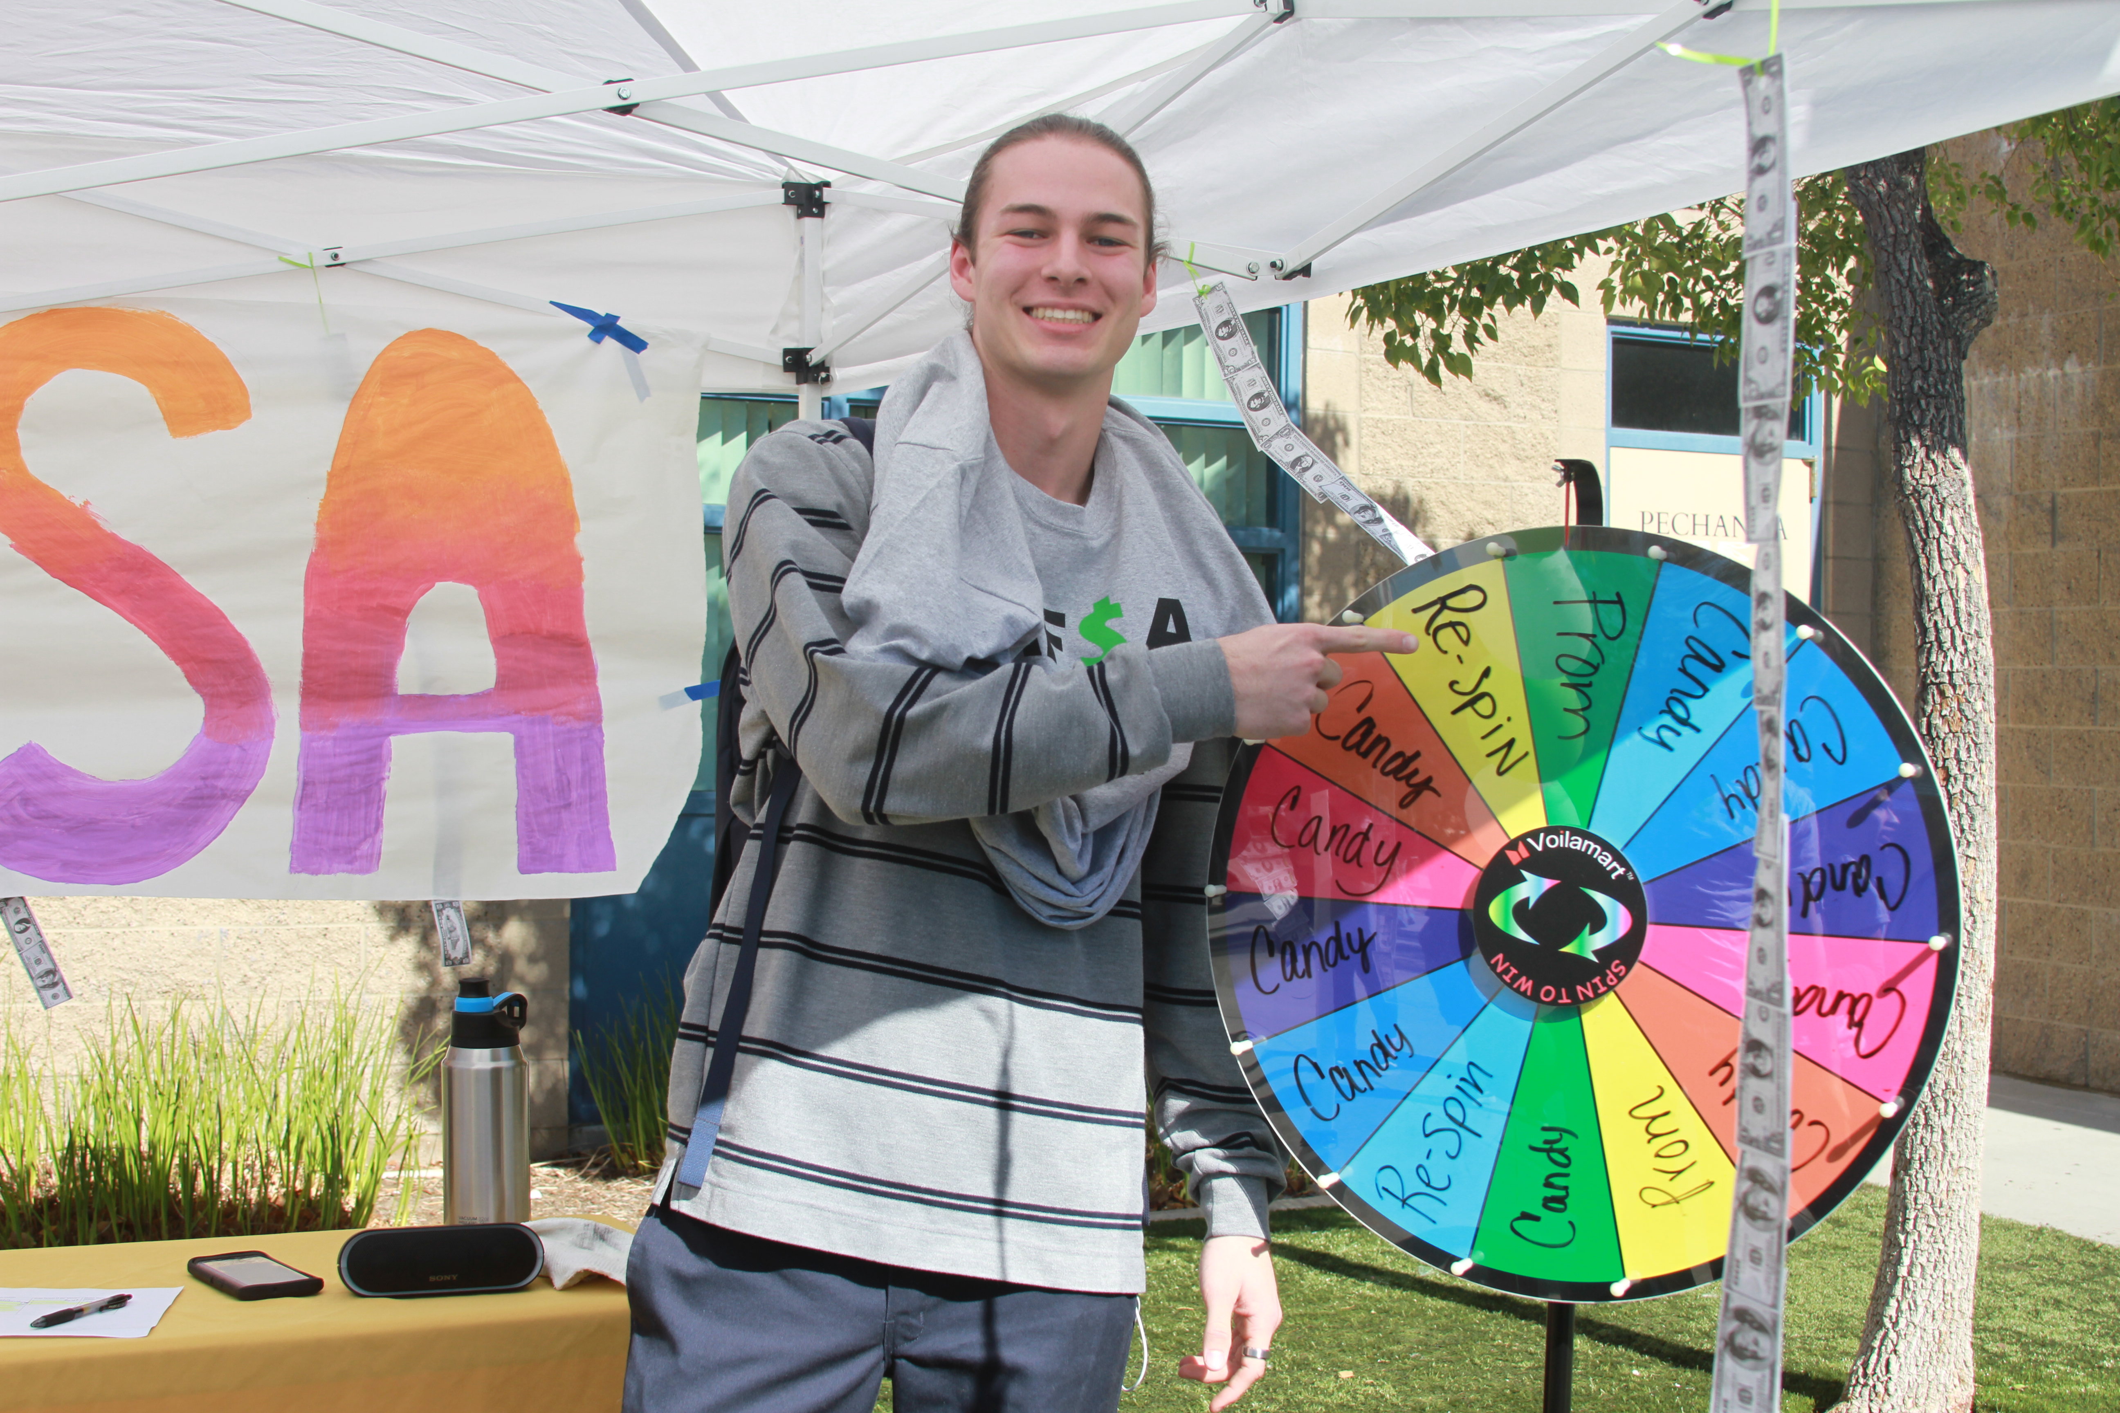
FAFSA/CADAA Announcements
Your Free Application for Federal Student Aid (FAFSA) or CADAA will be launched from your student's California Colleges account
The FAFSA window to apply is Oct. 1, 2022 – March 2, 2023
Oct 10th – Oct 14th FAFSA in classroom Presentations in Gov't/Econ class
FAFSA Incentives and drawings will be held throughout the year.
Students should print out their confirmation once they have filed and submitted their FAFSA application and bring it to Mrs. Osorio or Mrs. Padilla in the East Hall Counseling Office for their chance to win prizes, tickets and more (prom, extra graduation tickets, winter formal, grad nite).
Parent FAFSA Workshops: TBD

Slide 19
Riverside County Cal- Soap
The California Student Opportunity and Access Program (Cal-SOAP) was established by the state legislature in 1978. Today, Cal-SOAP is instrumental in improving the flow of information about post-secondary education and financial aid while raising the achievement levels of low-income, elementary and secondary school students or geographic regions with documented low-eligibility or college participation rates, and who are first in their families to attend college.
Meet Yesenia Carrillo, Cal Soap College Success Coach
Office Hours - Monday’s, Tuesday’s, and Friday’s from 9am-2pm
Email: ycarrillo_c@rcoe.us Phone Number: (909) 521-8470
Students can register for an appointment by using the following link: Virtual Coaches Support: https://a.flexbooker.com/reserve/rivcocalsoap#chooseService

Slide 20
Prepare for your AP Exams
Dates for 2022-2023 Program
All sessions will take place via zoom
2022 | 2023
September 24 October 22 November 5 December 10 | January 14 February 4 March 18 April 22
Prep sessions for AP Biology, AP Chemistry, AP Physics, AP Calculus AB, AP Statistics, AP English Language, AP English Literature, AP World History, AP Human Geography, AP US History, and AP Computer Science Principles.
Questions? Speak to your AP Teacher or Ms. Hill or Ms. Valenzuela

Slide 21
Announcements
11th-12th ASVAB Test date -October 12, 2022, sign up in Career Center
11th - PSAT – Saturday Oct. 15th purchase on www.vmhs.net or www.TotalRegistration.net/PSAT/053004
Deadline to purchase Oct 9th, $25 (Juniors only), PSAT test date
Senior Culminating Project (SCP) - Waived for Seniors
Junior / Senior Timelines with tonight’s schedule
Check the weekly Pony Express, monthly Counseling Newsletter, our school website, and Canvas Bronco Life & Counseling tile.
Notes:
Quick announcments
Not sure about PTSA. I have not heard back from them….

Slide 22
List of Resource Tables located in MPR
Army
Marines
MSJC
CSU San Marcos
UC Irvine
Grand Canyon University
FIDM
Cal Baptist University
PTSA
AP/Dual
NCAA
California Colleges (CCGI)
FAFSA/CADAA
Herff Jones
VMHS Counseling
School Wide Interventions

Slide 23
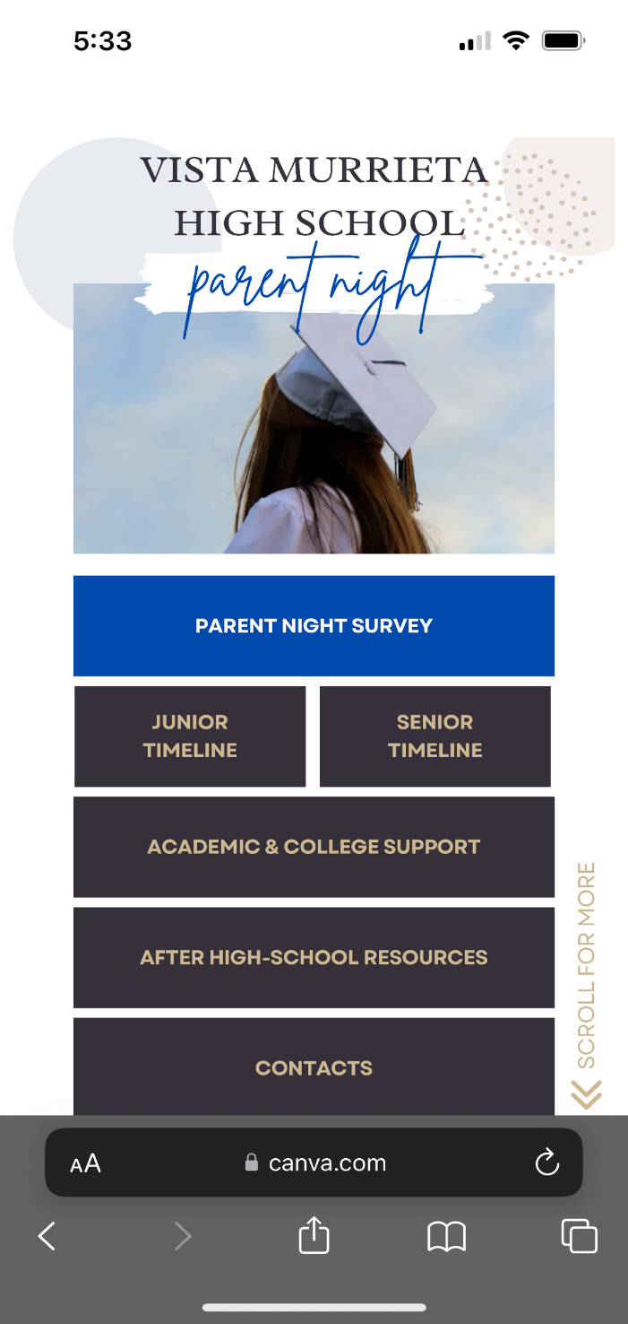
Please take a moment to fill out the Parent Night Feedback Survey at QR Code below. We appreciate your feedback.
Bit.ly/vmhsjs22

